Slide 1

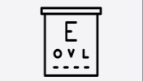
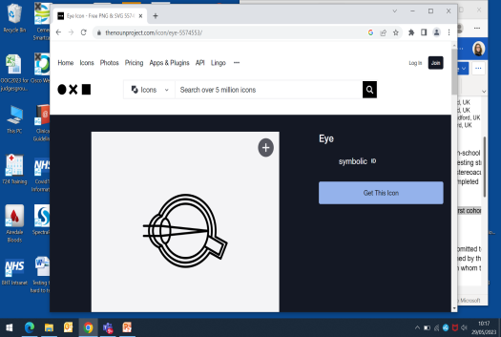
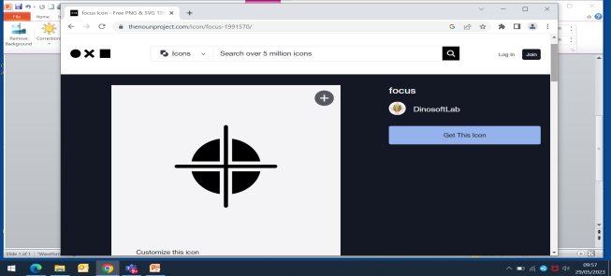
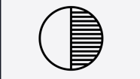
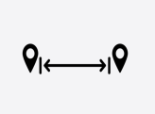
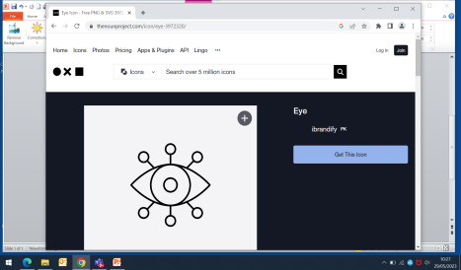
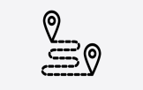

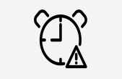
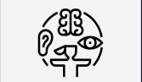

Finding the hard to reach: detecting CVI-related visual dysfunction in children with complex needs in the eye clinic.
Sidra Ahmed¹, Rachel F Pilling^{1,2}
1 Bradford Teaching Hospitals NHS Trust, 2 School of Optometry and Vision Science, University of Bradford, UK
Introduction
Cerebral Visual Impairment (CVI) is commonly associated with neurodevelopmental delay. This poses a diagnostic challenge when testing protocols to demonstrate visual dysfunction are beyond a child’s cognitive and/or motor abilities.
A variety of reflexive visual assessment techniques are routinely used in the eye clinic which do not require a child to comprehend instructions nor coordinate an upper limb motor response.
Formal diagnostic criteria for CVI have not been published. Locally a diagnosis of CVI is made if:
  Risk factor for CVI present
  Reported or observed atypical visual function is present
  Verified visual dysfunction evident on testing
Uncertainty about testing protocols remain a barrier to diagnosis (and support) for many children with complex needs.
acuity
refraction/accommodation
visual field/attention
contrast sensitivity
visual range
eye movements
motion perception
simultaneous recognition
visual attention/avoidance
sensory integration
optic disc assessment
Visual function domains
The aim of this evaluation
to analyse diagnostic thresholds for CVI in children with complex needs
to determine which reflexive tests may be usefully included in a CVI testing protocol
Methods
Retrospective casenote review of 50 consecutive patients attending a special needs eye clinic.
Tools and order of testing chosen by clinician to maximise engagement and attention.
Diagnosis of CVI made by an experienced paediatric ophthalmologist based on history and clinical features
Results
35 (70%) children were diagnosed with CVI.
Mean age of cohort was 6.6 years
10 (20%) children were able to engage with all testing domains
The mean number of tests completed was 7.2 for suspected CVI and 10.3 for non-CVI (p=0.19).
The mean number of atypical responses to tests for CVI vs non-CVI was 4 vs 0.5 (p=0.01).
The domains with the most atypical responses were
  Eye movements (86%)
  Simultaneous recognition (79%)
  Range (72%)
  Attention (71%)
Optic disc assessment was the least-performed domain.
Conclusions
An eye clinic assessment can demonstrate CVI-related visual dysfunction in children with special needs using simple readily available tools.
This approach can identify at-risk children who may benefit from discussion with a multidisciplinary team and facilitate timely diagnosis of CVI.
Clear documentation of areas of visual difficulty will enable advice and signposting of support strategies whilst awaiting formal diagnosis.

