Slide 1

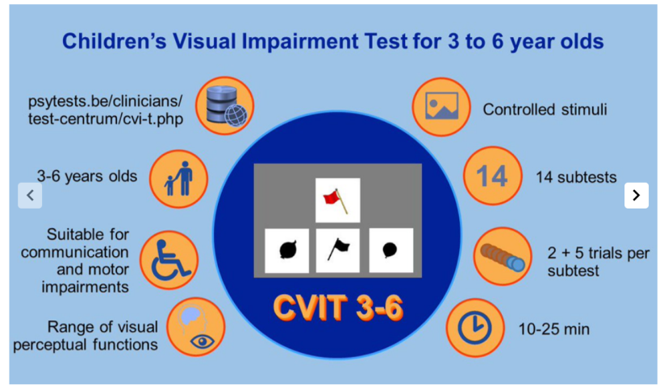
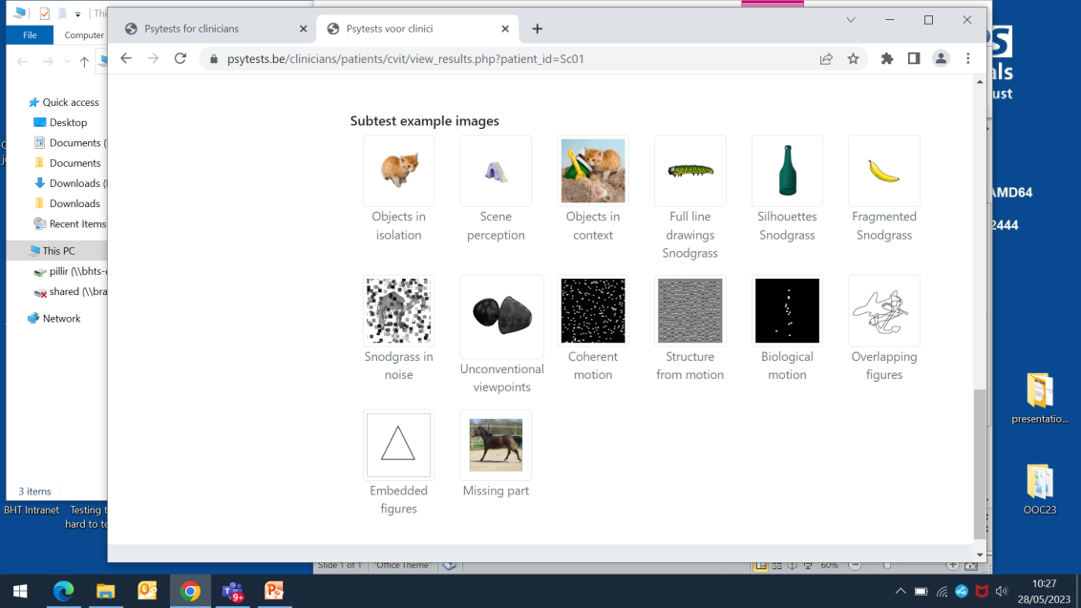
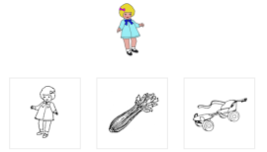
Early Years Examination for Cerebral Visual Impairment related dysfunction (EYE-CVI): a feasibility study
Brendan T Barrett, Rachel F Pilling
School of Optometry and Vision Science, University of Bradford, UK
Introduction
Recent studies have highlighted the prevalence of children within mainstream schools who have unrecognised Cerebral Visual Impairment (CVI)-related problems. There is a need for early detection of CVI-related dysfunction prior to entry into school.
AIM: We undertook a feasibility study to examine if Early Years Teams (EYT, nursery teachers) are able to undertake in-school testing at age 3-4 years to identify children who may benefit from further assessment.
Fig 1 Overview of Children’s Visual Impairment Test 3-6, https://kathleenvancleef.org/cvit-3-6/
Methods
Six mainstream EYT agreed to participate in training, with a target recruitment of 90 children.
Children were tested in the nursery school by a EYT familiar to them.
Data were collected on three elements of visual function: binocular crowded (C) /uncrowded (U) acuity at 30cm and 1.5m and CVIT3-6.
Fig 2 Subtest example images taken from https://psytests.be/clinicians/test-centrum/cvi-t.php
Results
Four nursery schools completed training. 36 children were recruited.
35 (97%) children were able to complete acuity testing, with a mean testing time of 5.1 minutes (range 3-13).
Five children (14%) were found to have acuity <0.3logMAR for either 1.5m (C) or 33cm (C). Four of these children were found to have normal acuity on retesting.
31 (86%) children attempted CVIT3-6 testing (mean testing time 15.1 minutes; range 11-26).
The mean CVIT3-6 score was 54.6 (range 33-68)
55% children were able to complete all 14 CVIT3-6 domains; the mean number of uncompleted testing domains was 0.9 (range 0-4).
The test domains with the highest rate of subthreshold responses were silhouette, fragmented and noise snodgrass, biological motion, overlapping figures
The most frequently skipped test domains were coherent motion, structure from motion (SFM) and missing part.
11/31 (35%) participants met the criteria for needing further assessment, scoring below the 10th centile score of 53.
Thirteen participants (42%) met the criteria for further assessment based on returning four-or-more subthreshold domain responses.
Conclusions
EYT are able to assess visual acuity in the nursery setting following a short training programme.
The CVIT3-6 takes longer to administer by EYT compared with a trained professional in a research setting.
Around half the children were able to complete the full assessment.
Using this protocol around 1:3 children would require more in-depth assessment
Our findings mirror published data with respect to testing domains which pose the greatest challenge for children
Further refinement of a testing protocol is required prior to undertaking a large scale study.

